Slide 1


Prof.V.B.Shah Institute of Management & R.V.Patel College of Commerce (Eng.Med.) & V.L.Shah College of Commerce (Guj.Med.) & Sutex Bank College of Computer Applications & Science, Amroli (Accredited ‘B’ (CGPA 2.55) by NAAC Dec.-2009) VEER NARMAD SOUTH GUJARAT UNIVERSITY, SURAT
Final Project Presentation for the degree of
Bachelor of Computer Applications
(BCA 6th Semester) Year : 2025-26
E-MARTZ
(online e-commerce shopping platform)
Guided by:
Prof. Himani Thakor
Submitted by:
109 1009 Mehul S. Chavda

Slide 2
E -MARTZ
online e-commerce shopping platform

Slide 3

TECHNOLOGY USED:
Front end : Html,JS
Styling : Css,Bootstrap
Backend : PHP
Database : MySQL

Slide 4

KEY CONCEPTS :
Customer Module:
The customer module allows users to register, log in, and browse products with filters such as category, size, and color. Customers can add products to their cart, make secure payments, and track their orders. They can also give feedback and reviews, making the shopping experience more interactive and reliable.
Admin module:
Seller Module:
The admin module provides centralized control of the entire system. Admins manage customers, sellers, and product categories while approving new seller registrations. They monitor transactions, oversee order and payment records, and review customer feedback. With full access to backend settings, admins ensure the smooth and secure operation of the marketplace.
The seller module is designed for vendors to manage their online business. Sellers can register, upload and update product listings with images, handle orders, and track payment history. They can also generate sales reports, giving them insights into their business performance. Admin approval ensures only verified sellers operate on the platform.

Slide 5

OBJECTIVE & GOAL :
Objective:
The objective is to provide a complete online shopping platform where customers can easily browse, purchase, and review products. At the same time, sellers get a secure space to manage their products, orders, and payments, while the admin ensures smooth and reliable platform operations.
Goal:
The goal is to build a user-friendly, secure, and scalable e-commerce system. It aims to deliver convenience for customers, growth opportunities for sellers, and centralized control for admins, ensuring a seamless and trusted online shopping experience.

Slide 6

BENEFITS :
Lower Costs :
Saves money on rent, utilities, and physical store expenses.
Scalability :
Easy to add more products or expand services without large investment.
Data Analytics:
Track customer behavior, sales trends, and improve decision-making.
24/7 Availability:
Customers can shop anytime, increasing sales opportunities.

Slide 7

FUTURE IMPROVEMENTS :
AI & Personalization :
Smarter product recommendations, chatbots, and customized shopping experiences.
AR/VR Shopping :
Virtual try-on and immersive product visualization.
Faster Delivery :
Drone, robot, and same-day delivery innovations.
Sustainable Practices :
Eco-friendly packaging and green logistics.

Slide 8

KNOWN ISSUES:
Order Tracking :
Order tracking is limited to static updates and does not include real-time logistics integration, which reduces transparency for customers.
Customer Support :
Help and FAQ sections are static and do not provide interactive support features like chatbots or live assistance, which may affect user satisfaction.
Privacy & Compliance:
The site has a privacy policy but it does not fully follow global standards like GDPR.

Slide 9
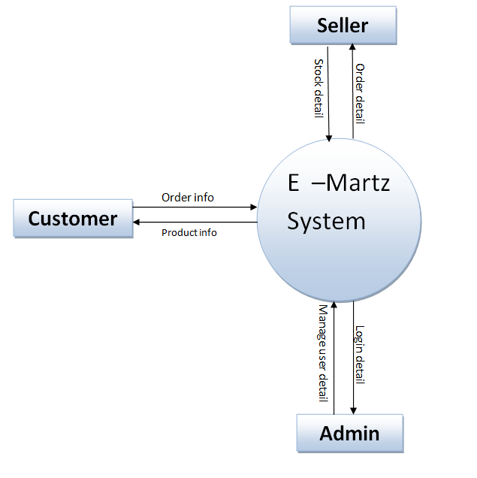
DATA FLOW DIAGRAM :
DFD LEVEL 0 :
Customers place orders and get product details, sellers update stock and receive order information, while the admin manages login and user details. The system acts as a central hub ensuring smooth coordination between customers, sellers, and the admin.

Slide 10
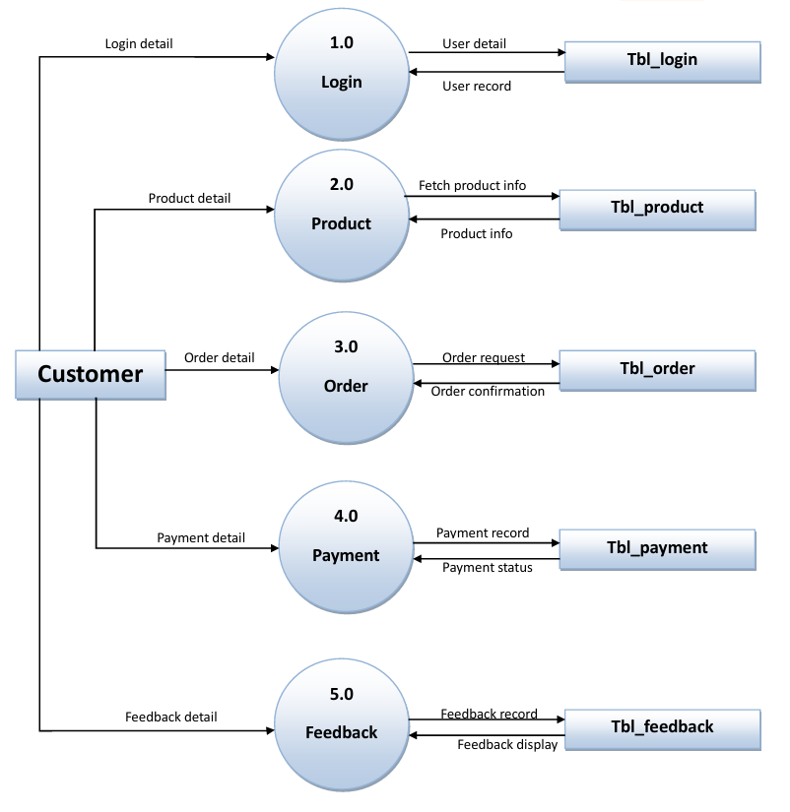
DATA FLOW DIAGRAM :
DFD LEVEL 1-CUSTOMER:
The customer can log in, view products, place an order, make a payment, and give feedback. Each action is connected to the system’s database, which stores login, product, order, payment, and feedback details.

Slide 11
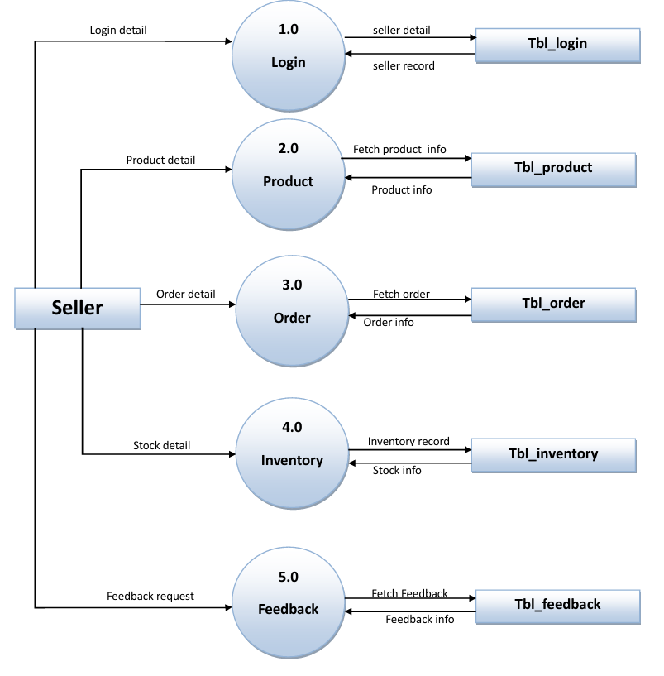
DATA FLOW DIAGRAM :
DFD LEVEL 1-SELLER:
The seller starts by logging in to confirm their details. After that, they can add or update products, manage customer orders, check and update stock in inventory, and handle customer reviews through feedback. Each step is linked to its own database table for saving and getting information.

Slide 12
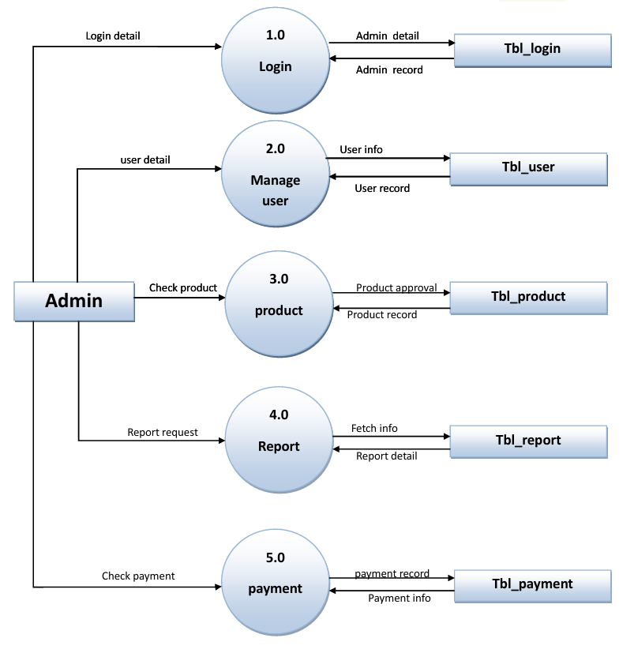
DATA FLOW DIAGRAM :
DFD LEVEL 1-ADMIN:
The admin can log in, manage users, approve products, view reports, and check payments. Each process is linked to its own database table for storing and retrieving information.

Slide 13
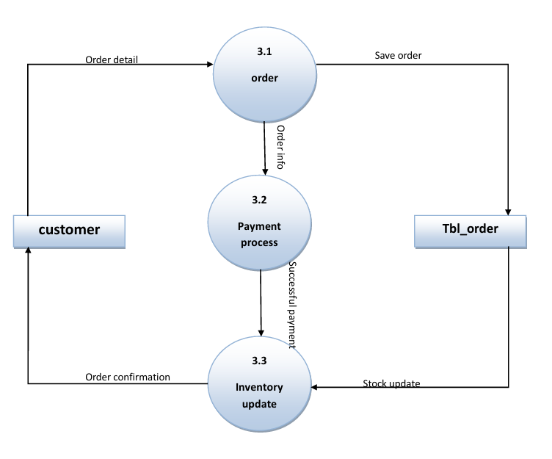
DATA FLOW DIAGRAM :
DFD LEVEL 2-CUSTOMER:
the customer places an order, makes the payment, and then the system updates inventory and sends order confirmation.

Slide 14
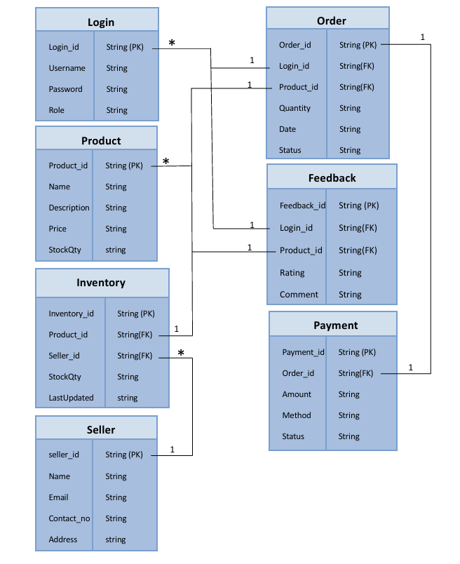
ENTITY RELATIONSHIP(ER) :
ENTITIES:
Login, Product, Order, Payment, Feedback, Inventory, Seller
RELATIONSHIPS:
Customer → Order (1:M)
Product → Order (1:M)
Order → Payment (1:1)
Customer → Feedback (1:M)
Product → Feedback (1:M)
Seller → Inventory (1:M)

Slide 15
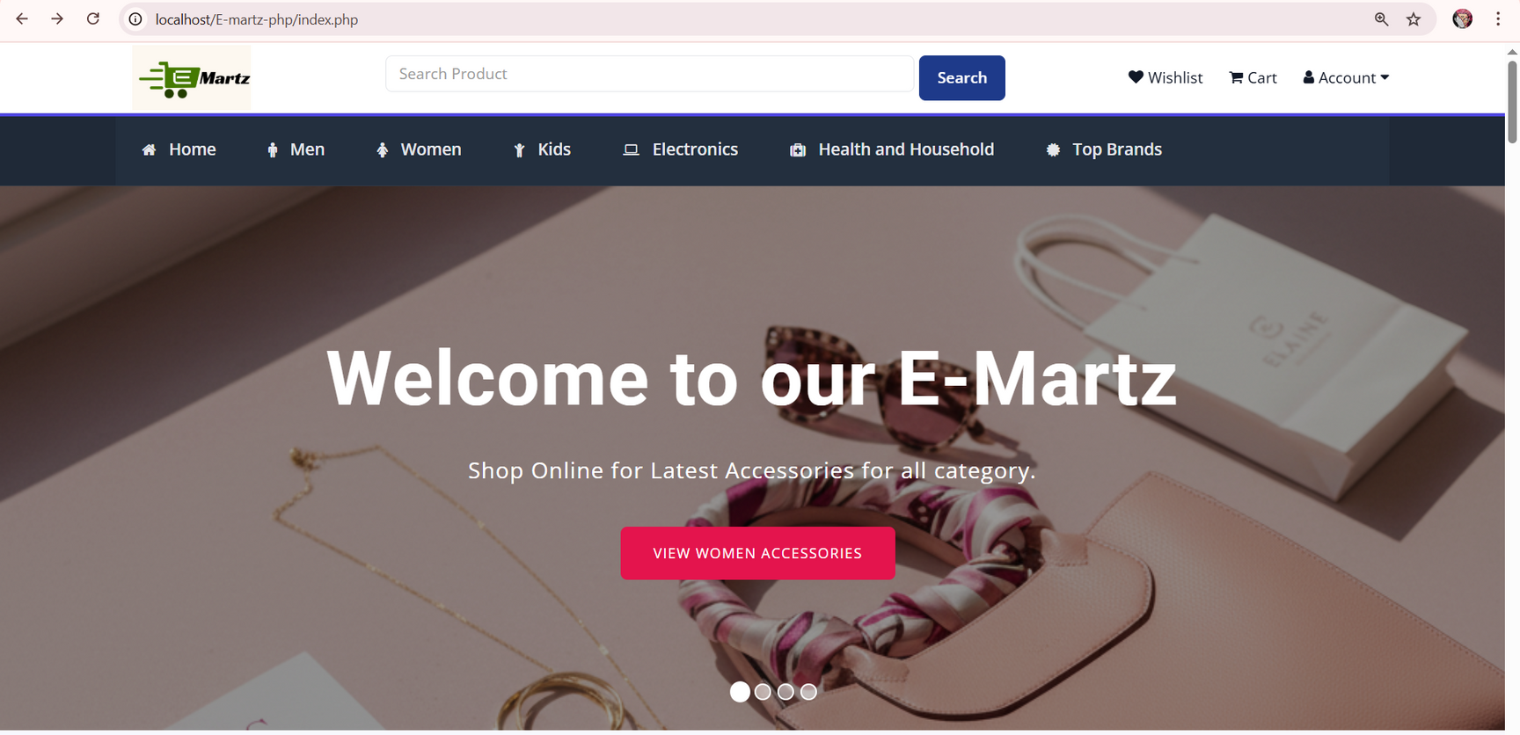
SYSTEM DESIGN
HOME PAGE :

Slide 16
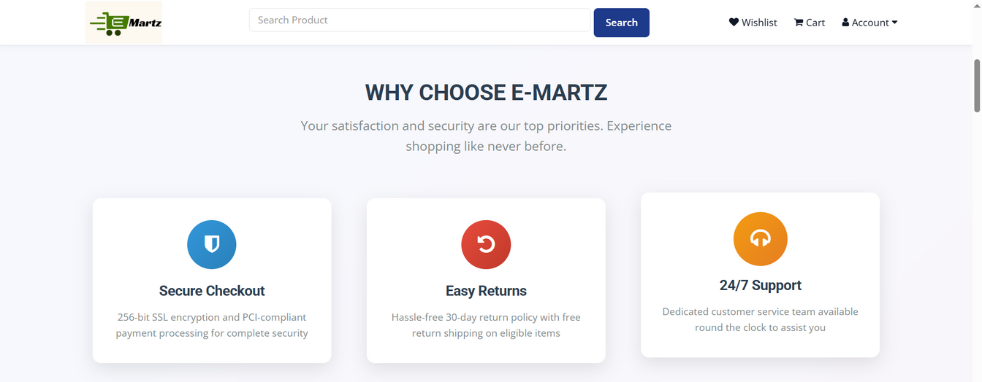
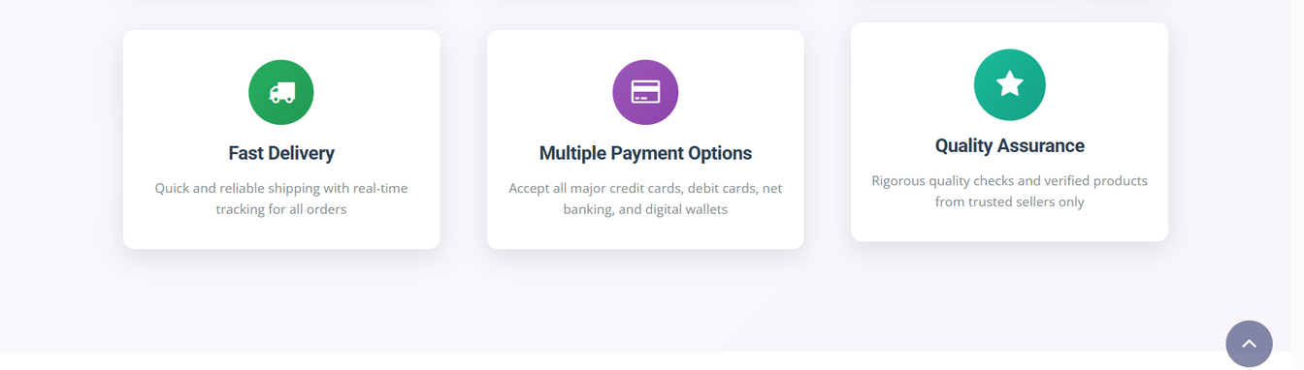
SYSTEM DESIGN
The Features page :

Slide 17
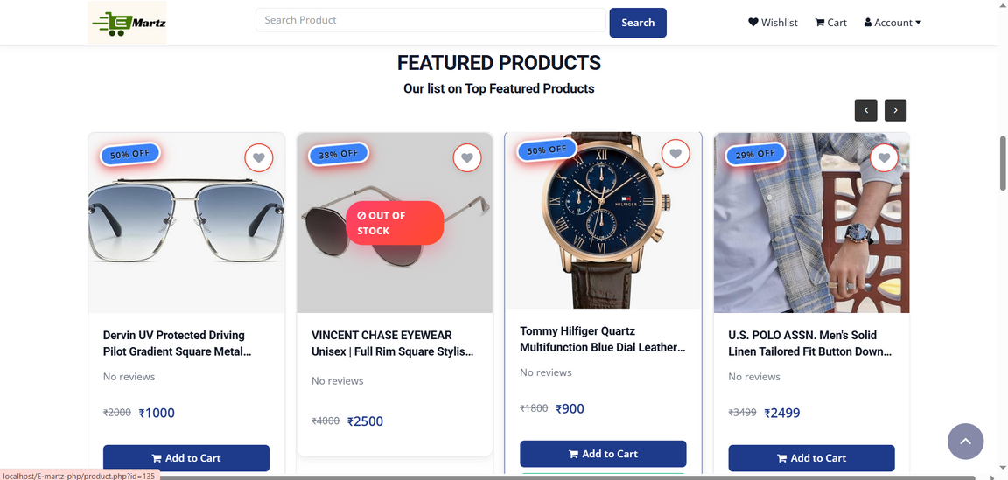
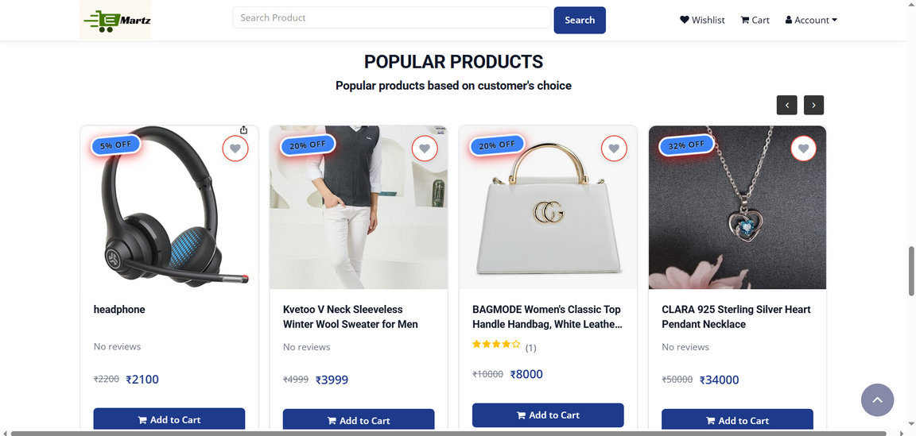
SYSTEM DESIGN
Featured product :
Latest product :

Slide 18
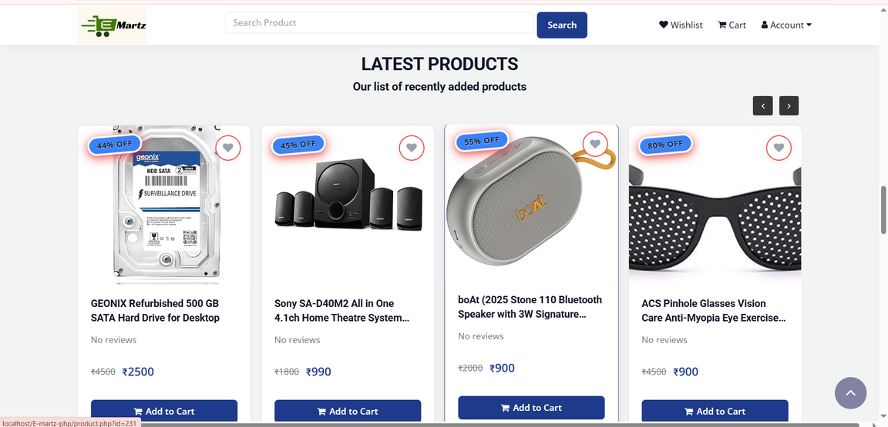
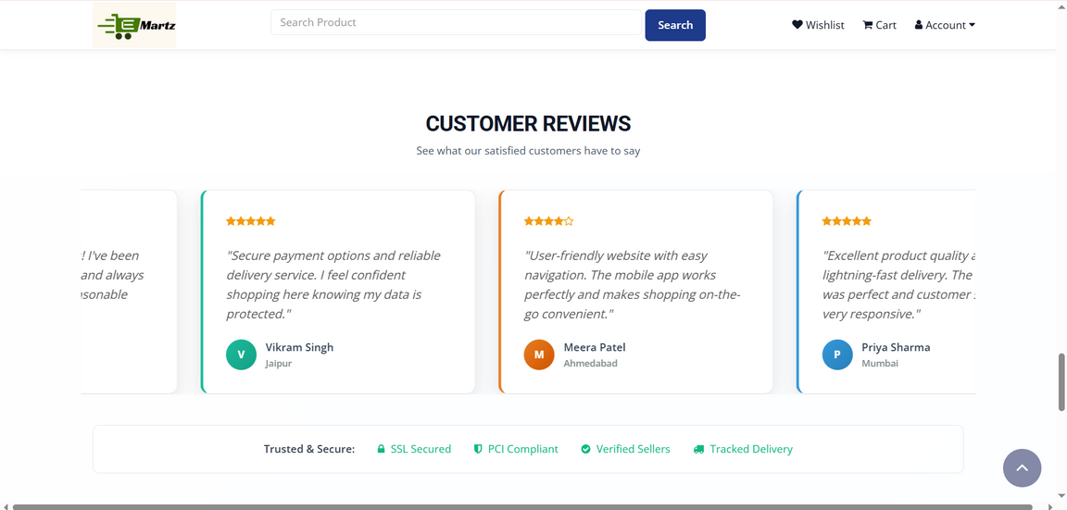
SYSTEM DESIGN
Popular product :
Customer reviews :

Slide 19
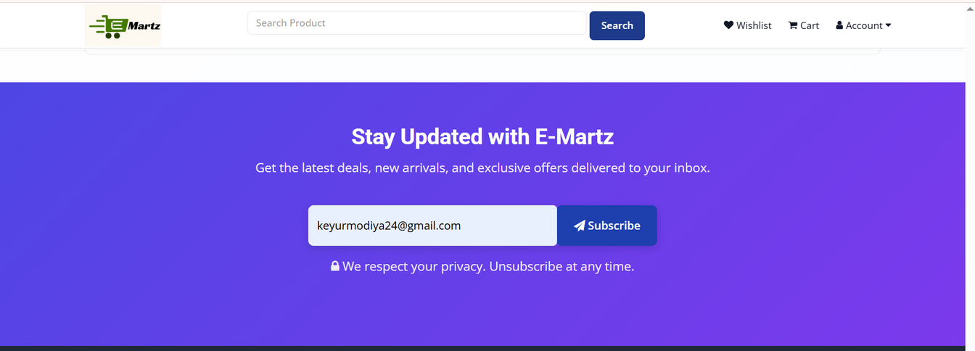
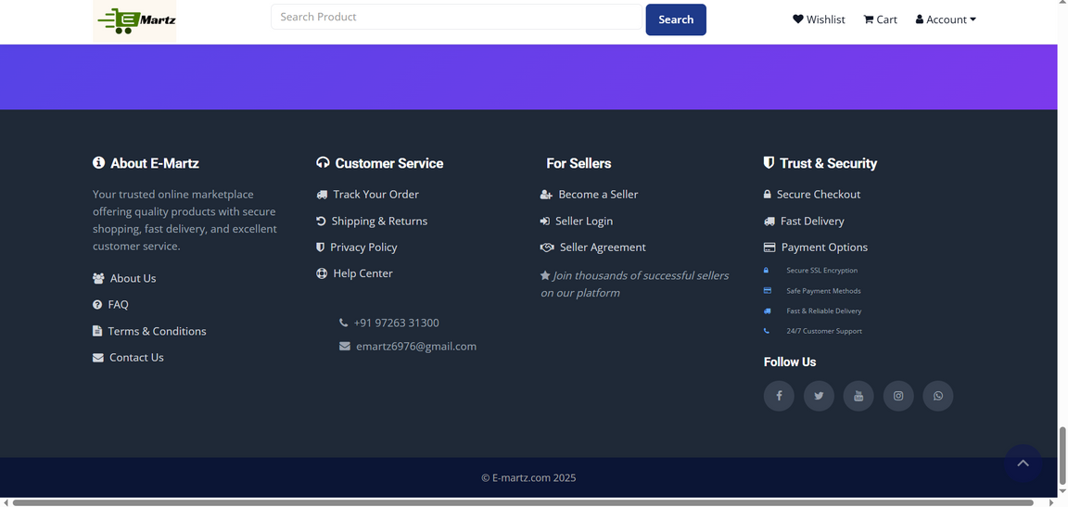
SYSTEM DESIGN
Subscribe page :
Footer:

Slide 20
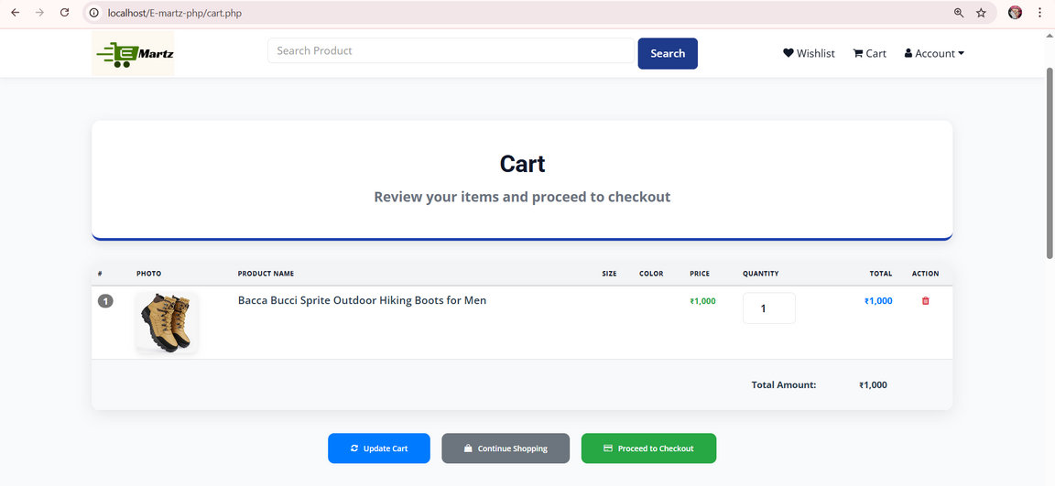
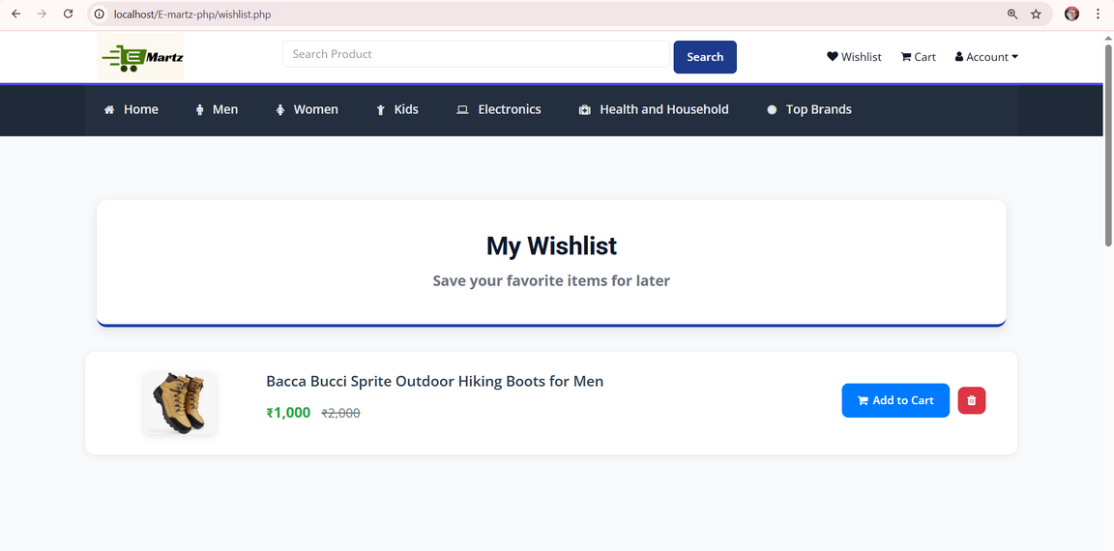
SYSTEM DESIGN
Cart :
Wishlist :

Slide 21
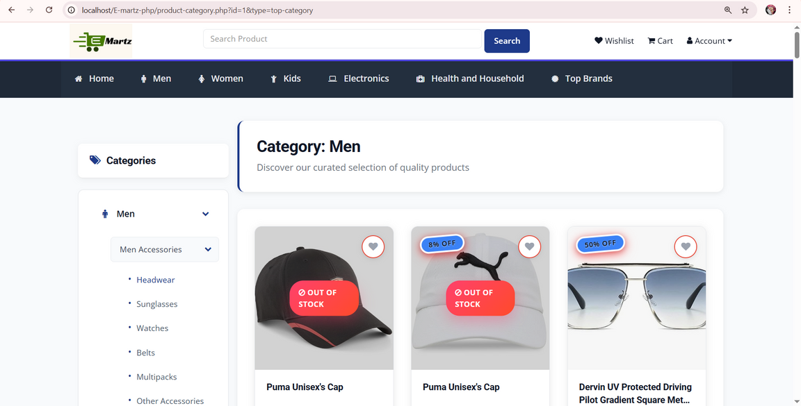
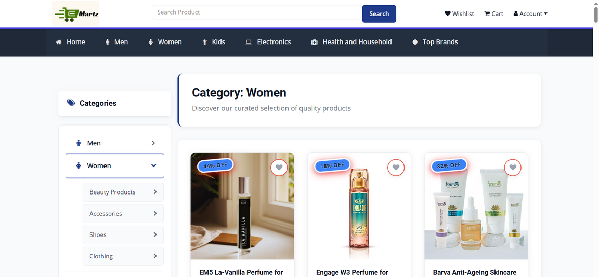
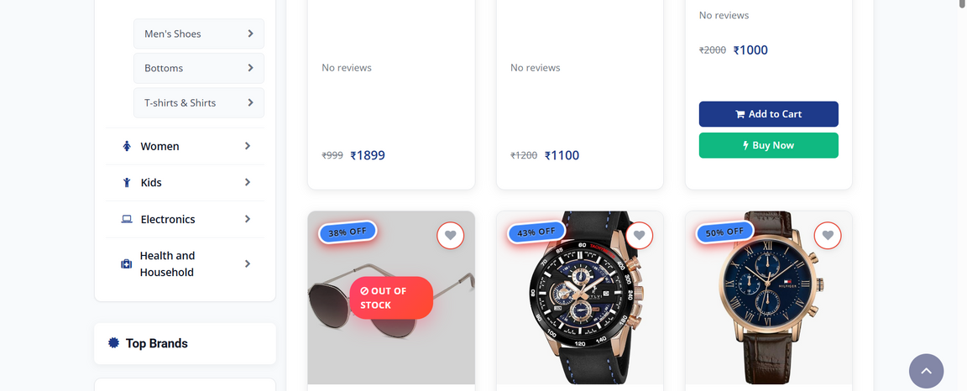
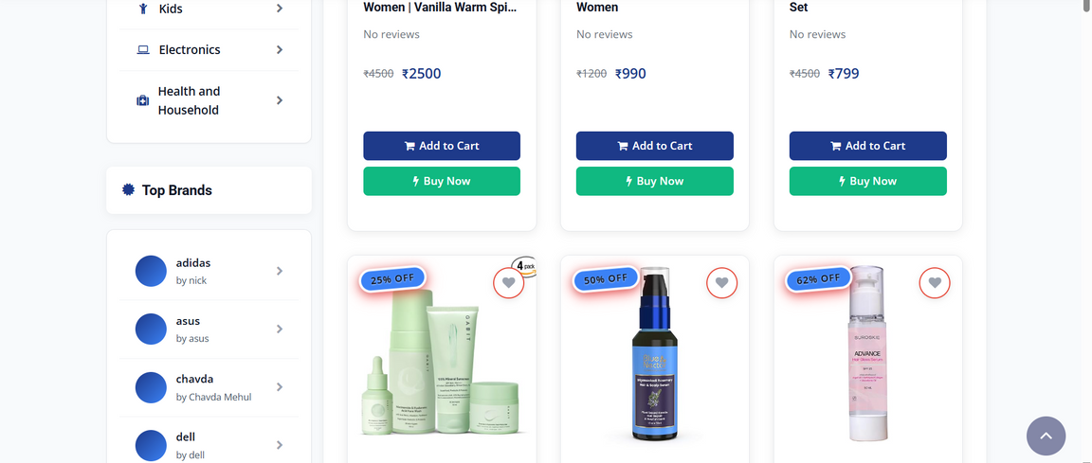
SYSTEM DESIGN
Category -MEN :
Category-WOMEN :

Slide 22
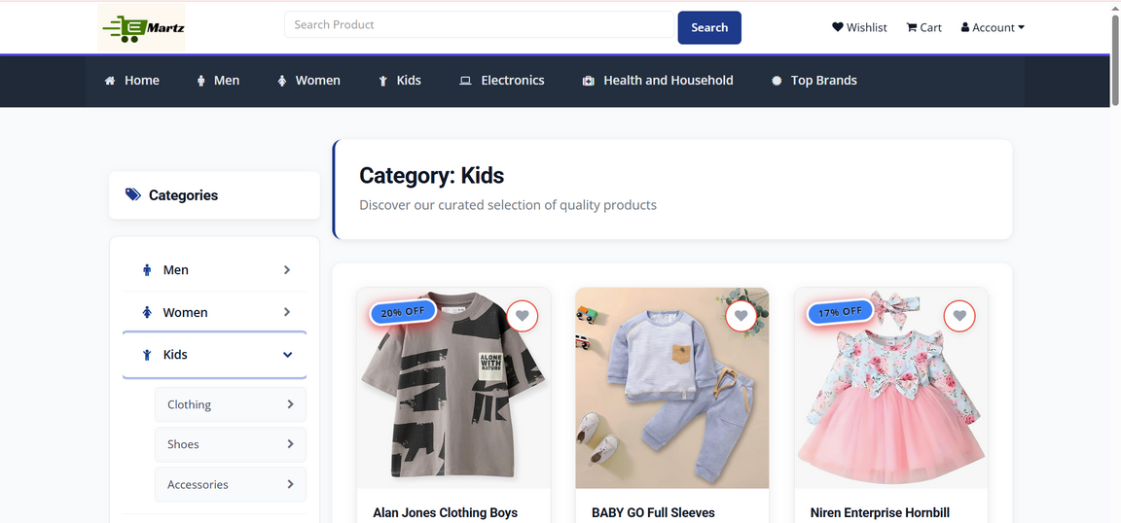
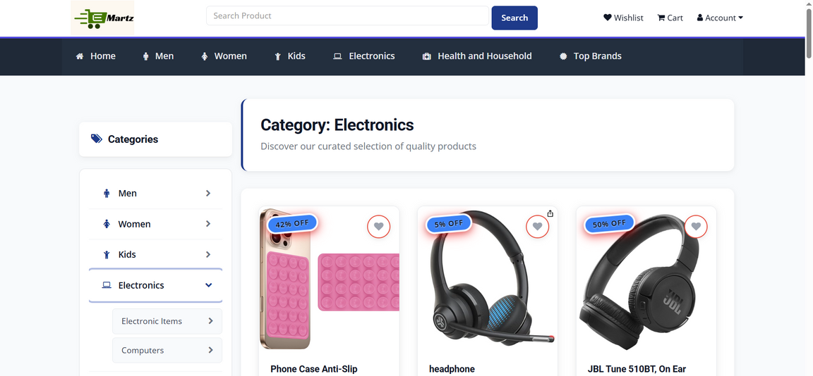
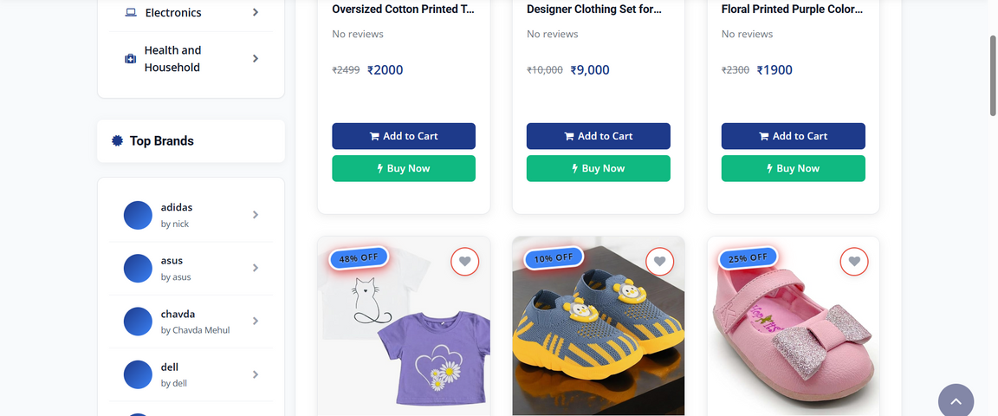
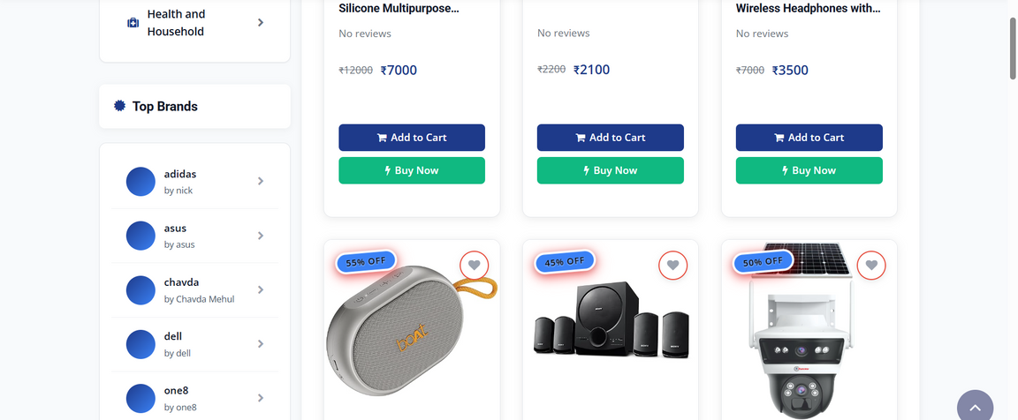
SYSTEM DESIGN
Category-KID :
Category-Electronics :

Slide 23
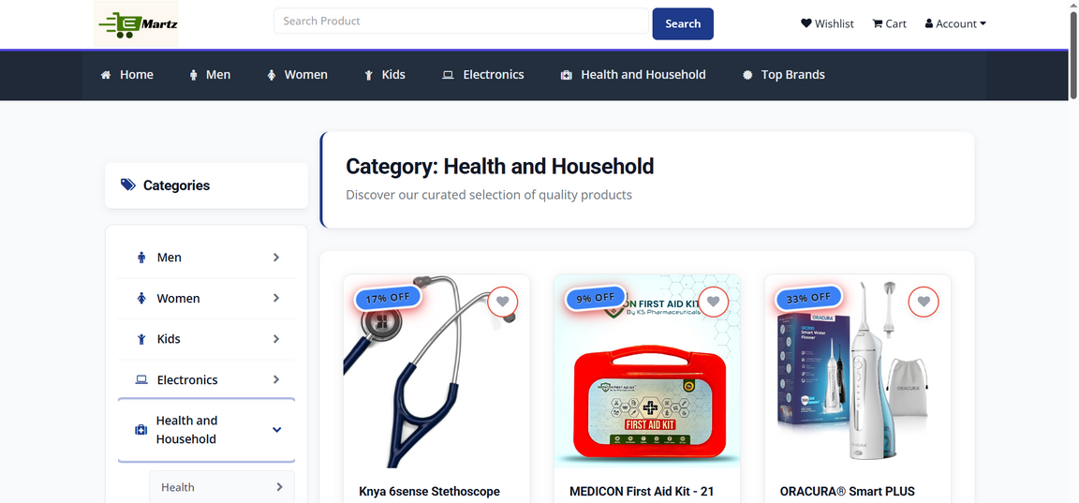
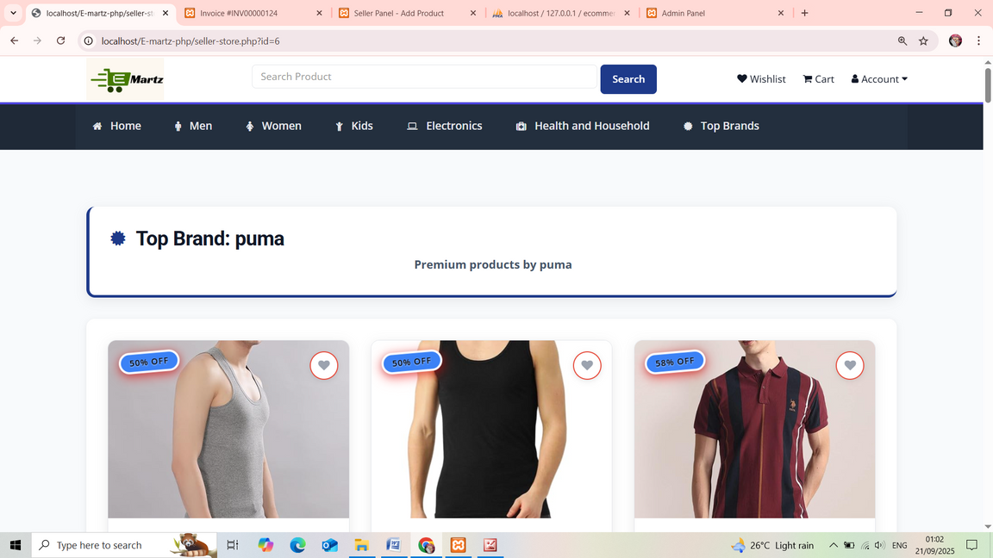
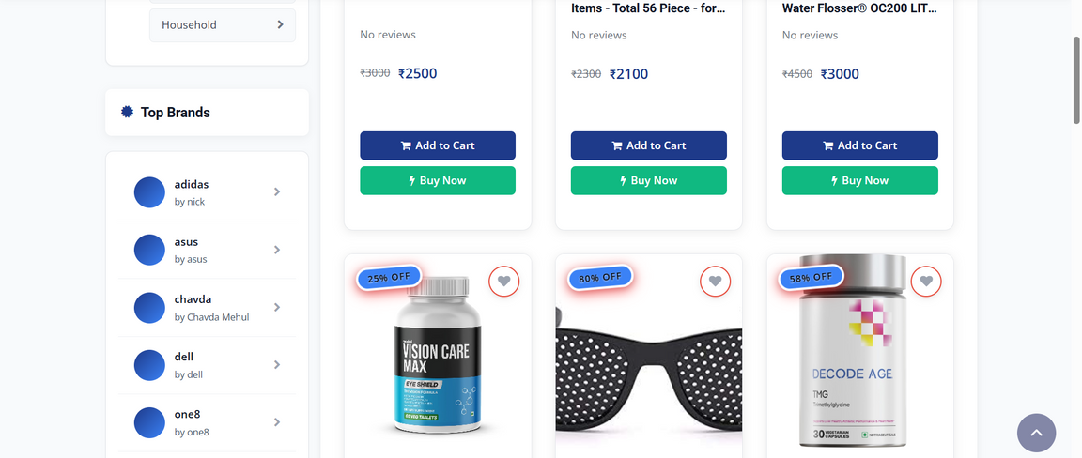
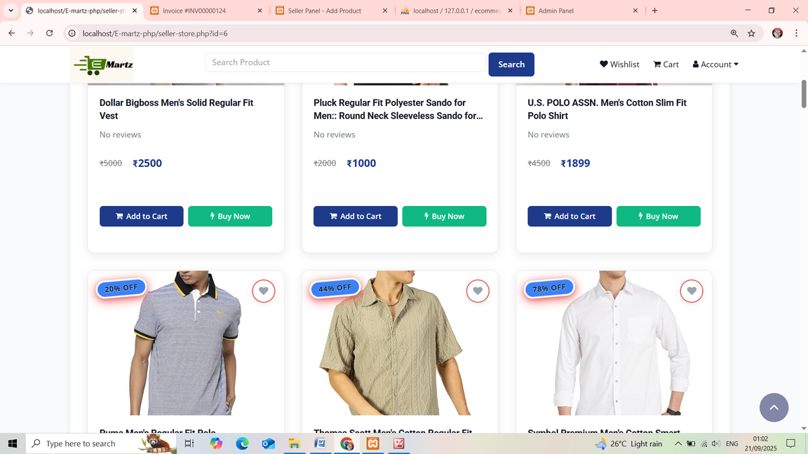
SYSTEM DESIGN
Category-Health & Household :
Category-Top Brand:

Slide 24
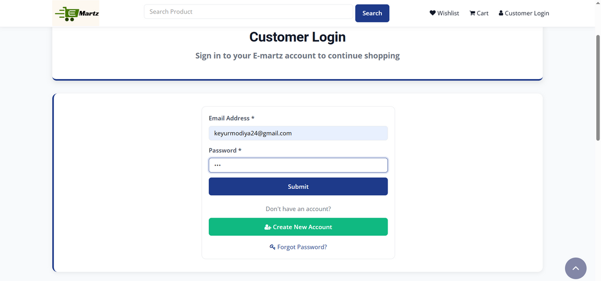
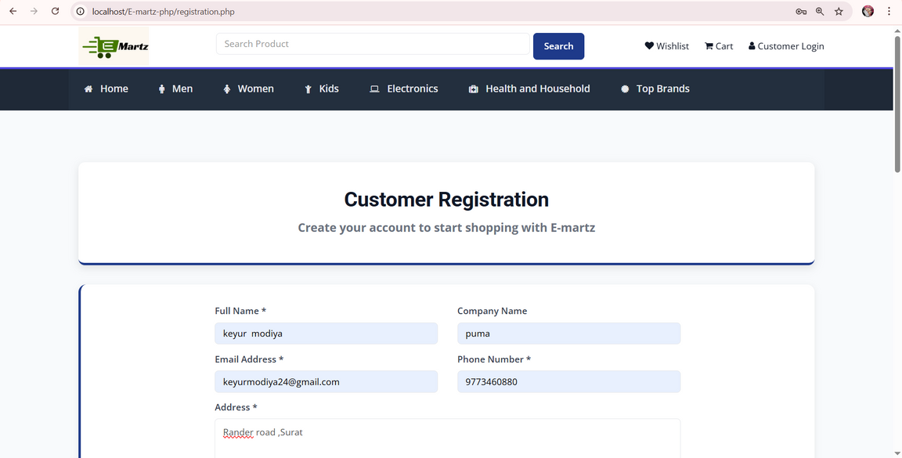
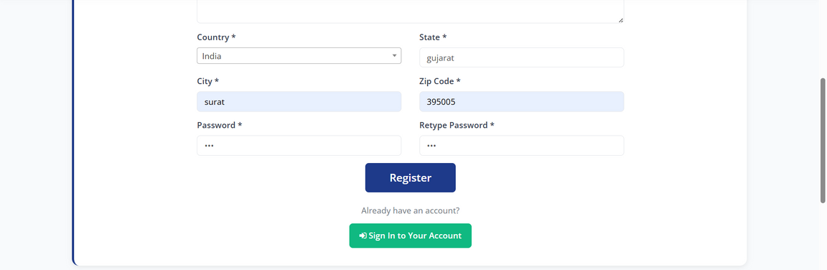
SYSTEM DESIGN
Customer Login :
Customer Registration :

Slide 25
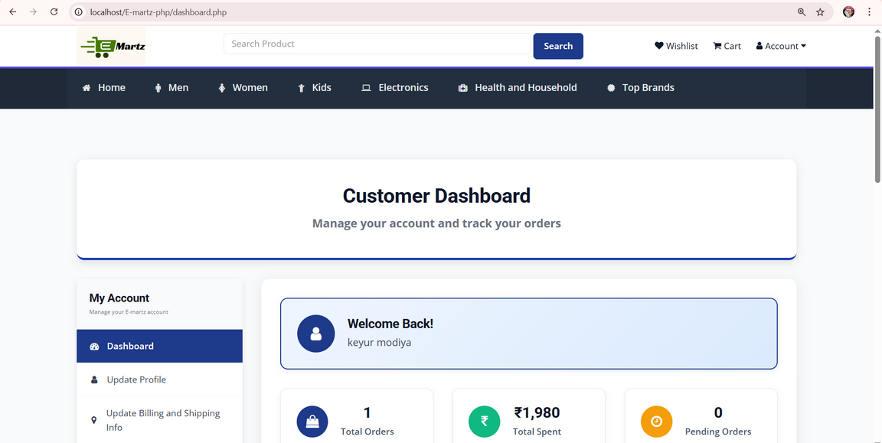
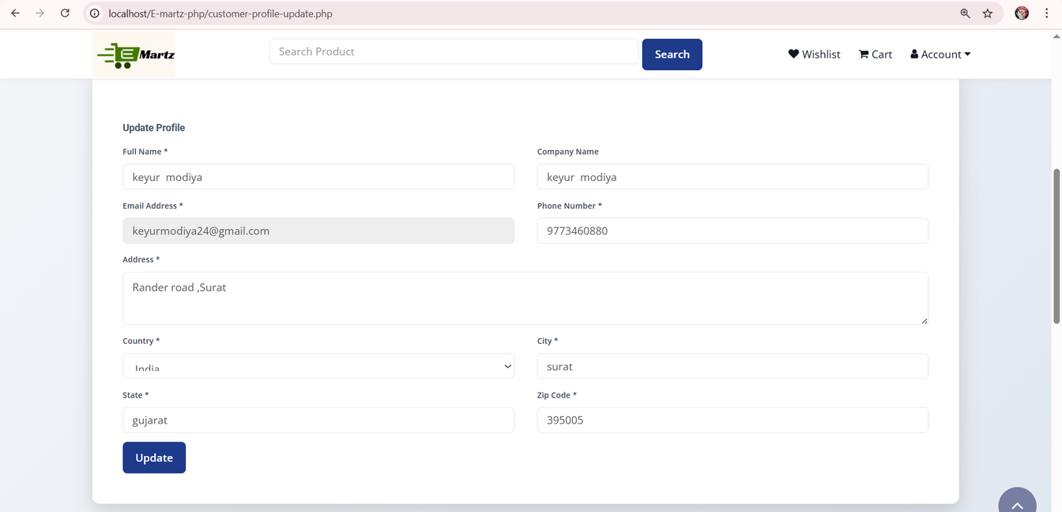
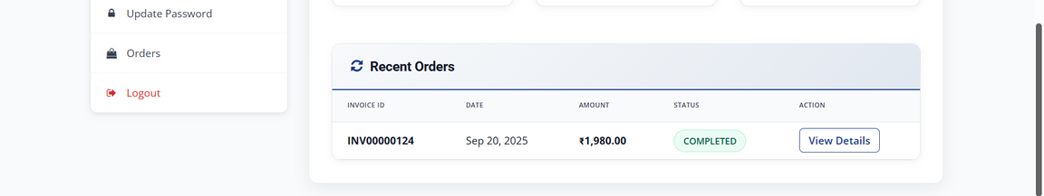
SYSTEM DESIGN
Customer Dashboard :
Customer Update Profile :

Slide 26
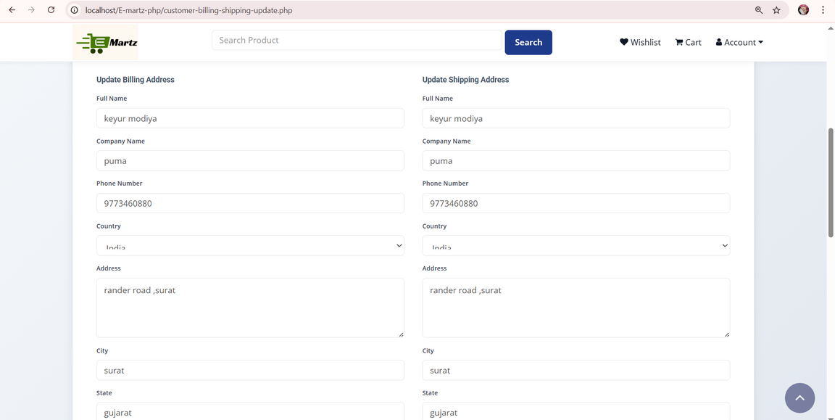
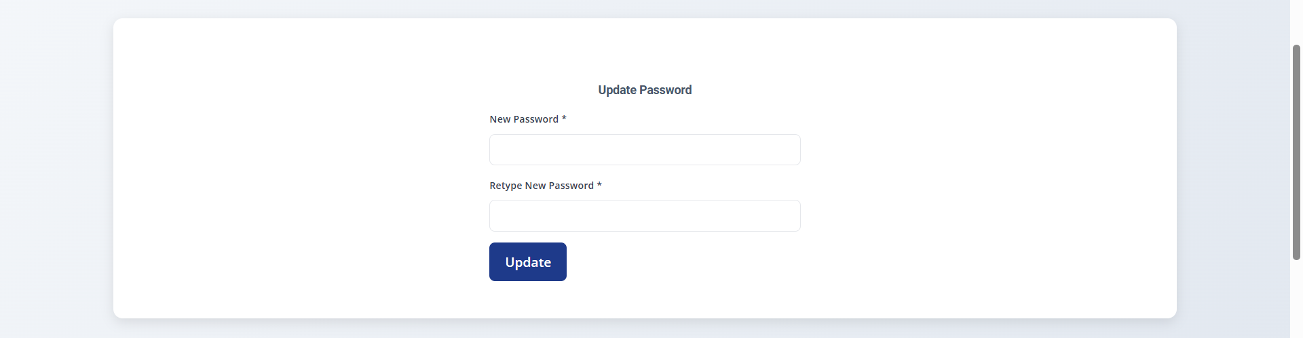
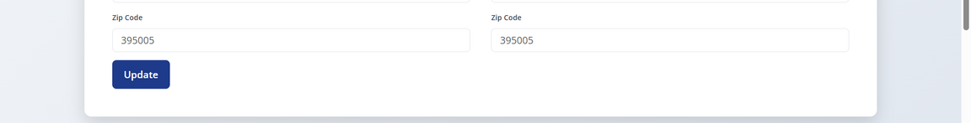
SYSTEM DESIGN
Customer Update Billing & Shipping info :
Customer Update password :

Slide 27
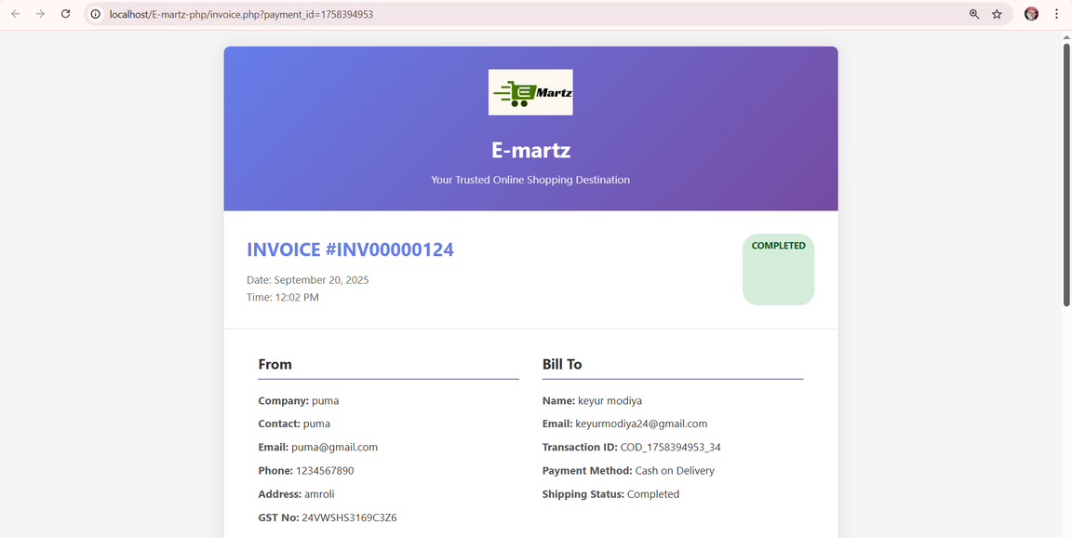
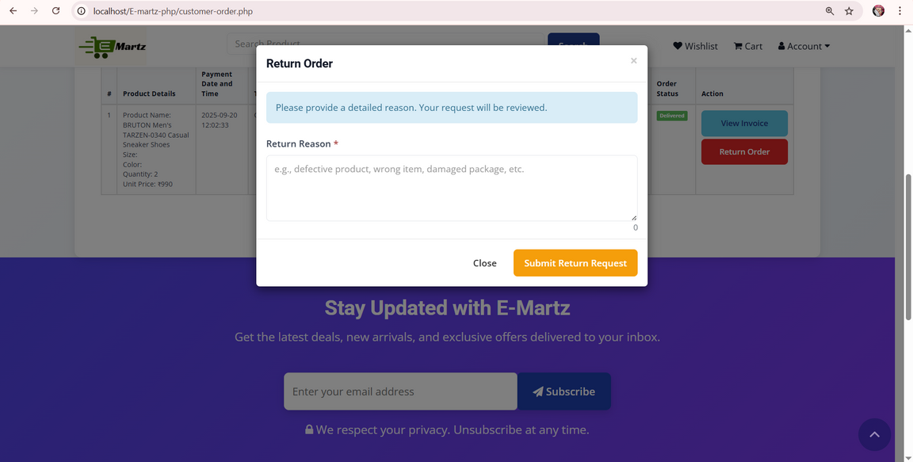
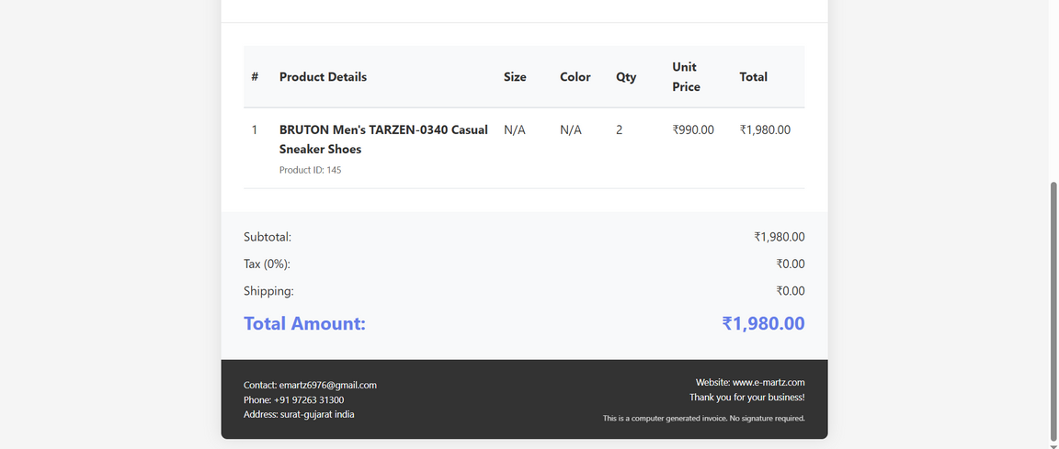
SYSTEM DESIGN
Invoice :
Return Order :

Slide 28
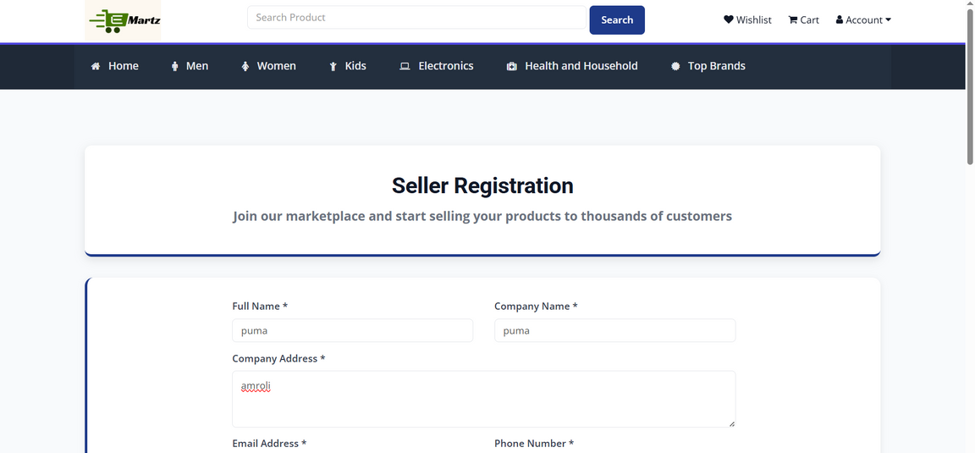
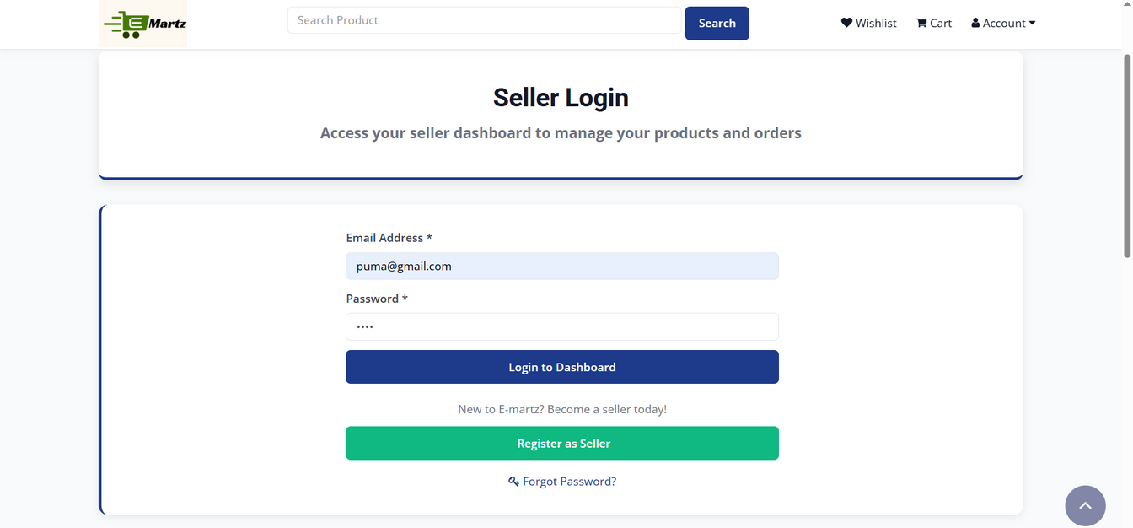
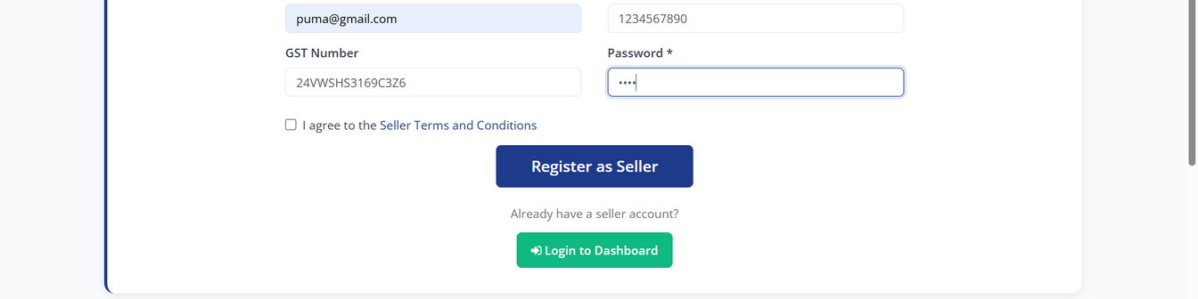
SYSTEM DESIGN
Seller Registration :
Seller Login :

Slide 29
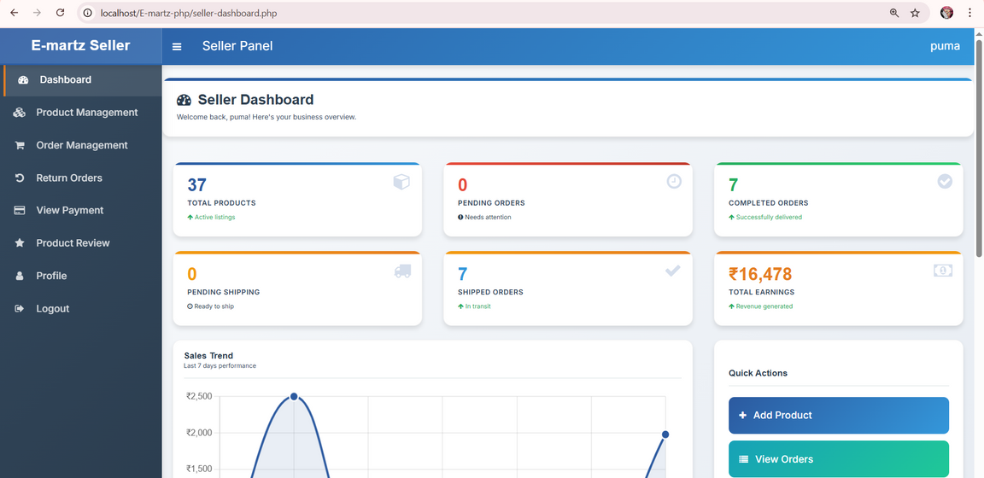
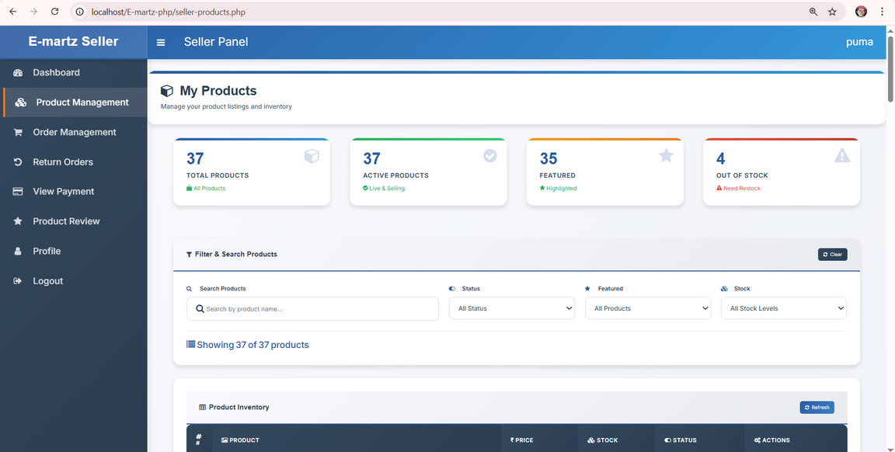
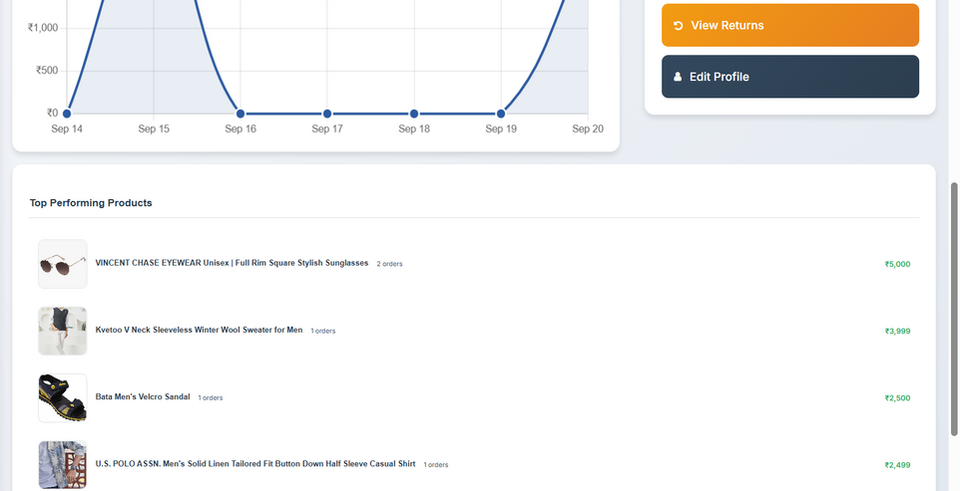
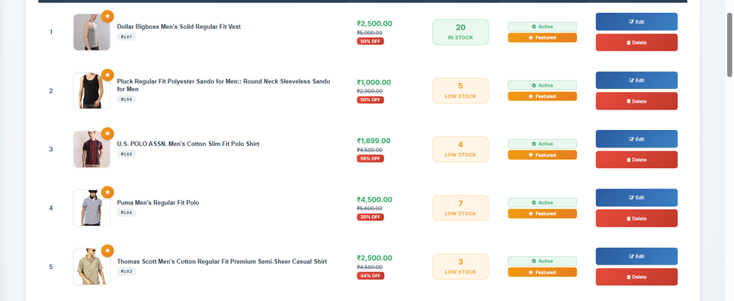
SYSTEM DESIGN
Seller Dashboard :
Product Management :

Slide 30
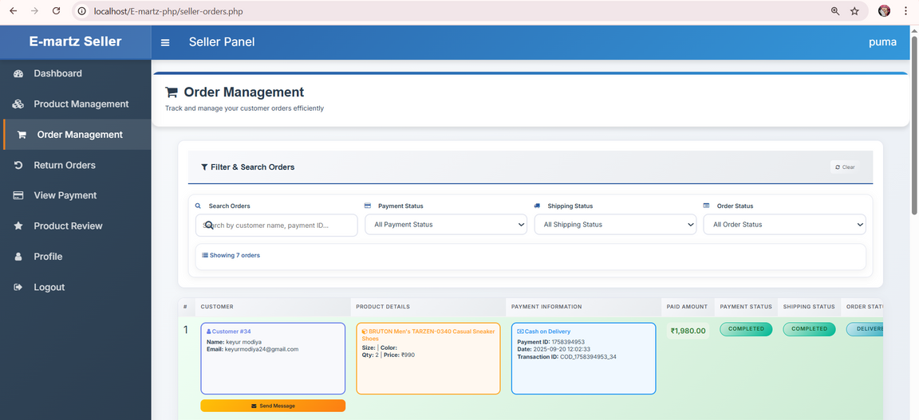
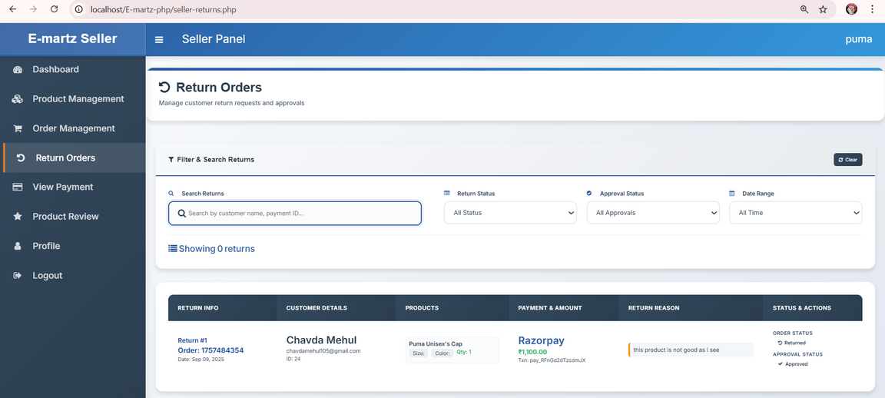
SYSTEM DESIGN
Order Management :
Return Orders :

Slide 31


SYSTEM DESIGN
Payment management :

Slide 32



SYSTEM DESIGN
Product reviews :
seller profile :

Slide 33



SYSTEM DESIGN
Admin Login :
Add new Admin User :

Slide 34




SYSTEM DESIGN
Admin Dashboard :
Admin profile :

Slide 35


SYSTEM DESIGN
Website Settings :
Shop Settings :

Slide 36


SYSTEM DESIGN
Admin product management:
Admin Order management:

Slide 37


SYSTEM DESIGN
Return Orders management:
Customer management:

Slide 38


SYSTEM DESIGN
Seller management:
Customer reviews management:

Slide 39


SYSTEM DESIGN
Contact Message management:
Subscriber management:

Slide 40


SYSTEM DESIGN
Page Settings:
Social Media setting:

Slide 41

SYSTEM DESIGN
User management:

Slide 42
Thank you

